Slide 1
ENEL 441
Control Systems I
Arne Dankers
10-01-2023

Slide 2
Review
Complex numbers
Linear Algebra
Differential Equations
Transfer Functions
Last week
today
Today we will focus on the mechanics of finding solutions

Slide 3
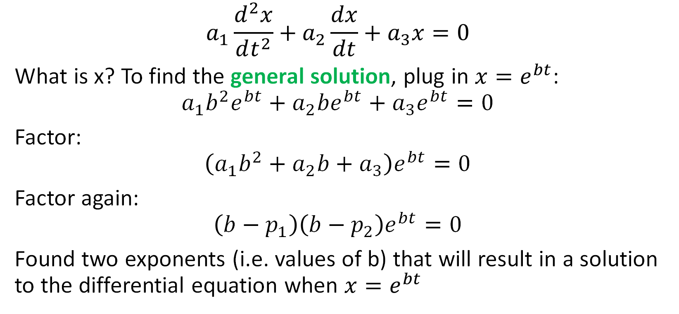
Differential Equations
$$a_{1}\frac{d^{2}x}{dt^{2}}+a_{2}\frac{dx}{dt}+a_{3}x=0$$
What is x? To find the general solution, plug in $x=e^{bt}$:
$$a_{1}b^{2}e^{bt}+a_{2}be^{bt}+a_{3}e^{bt}=0$$
Factor:
$$\left(a_{1}b^{2}+a_{2}b+a_{3}\right)e^{bt}=0$$
Factor again:
$$\left(b−p_{1}\right)\left(b−p_{2}\right)e^{bt}=0$$
Found two exponents (i.e. values of b) that will result in a solution to the differential equation when $x=e^{bt}$

Slide 4
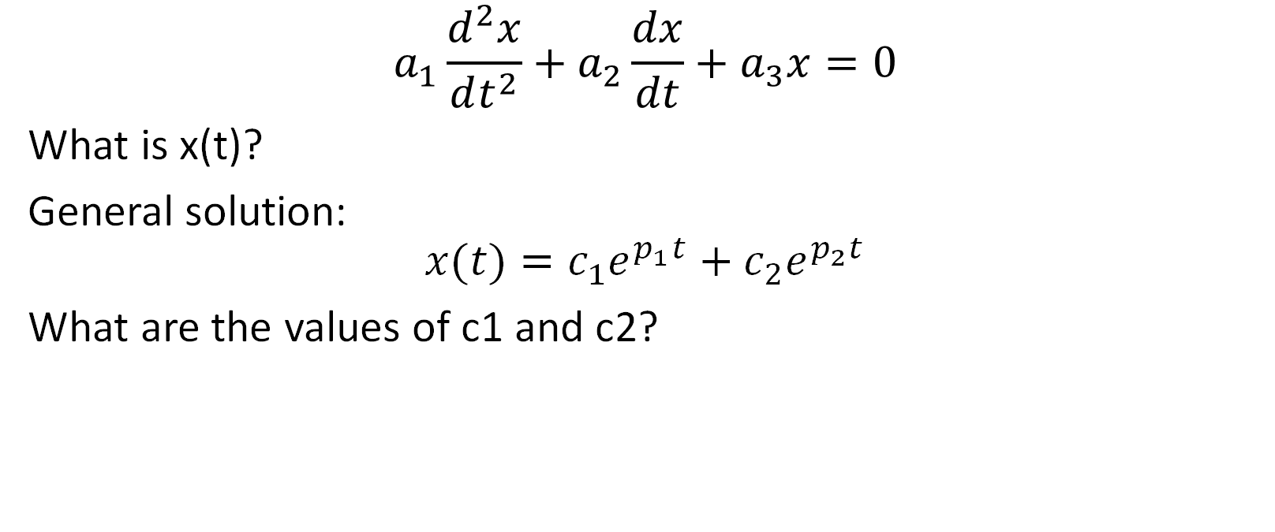
Differential Equations
$$a_{1}\frac{d^{2}x}{dt^{2}}+a_{2}\frac{dx}{dt}+a_{3}x=0$$
What is x(t)?
General solution:
$$x(t)=c_{1}e^{p_{1}t}+c_{2}e^{p_{2}t}$$
What are the values of c1 and c2?

Slide 5
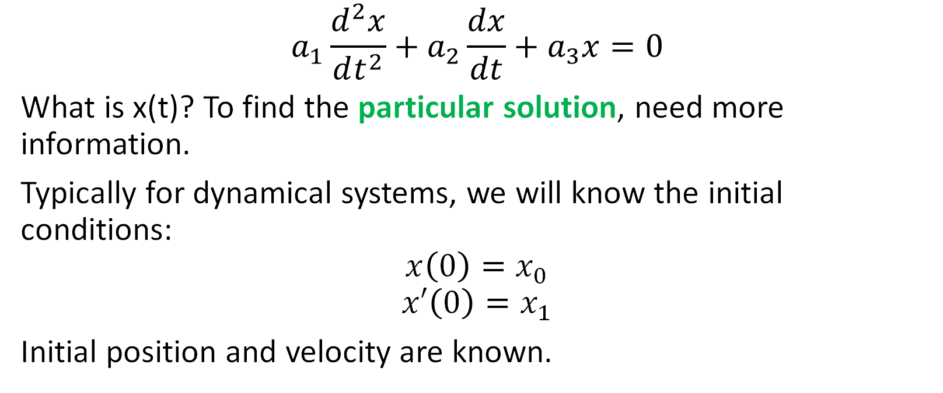
Differential Equations
$$a_{1}\frac{d^{2}x}{dt^{2}}+a_{2}\frac{dx}{dt}+a_{3}x=0$$
What is x(t)? To find the particular solution, need more information.
Typically for dynamical systems, we will know the initial conditions:
$$x\left(0\right)=x_{0}$$
$$x′\left(0\right)=x_{1}$$
Initial position and velocity are known.

Slide 6
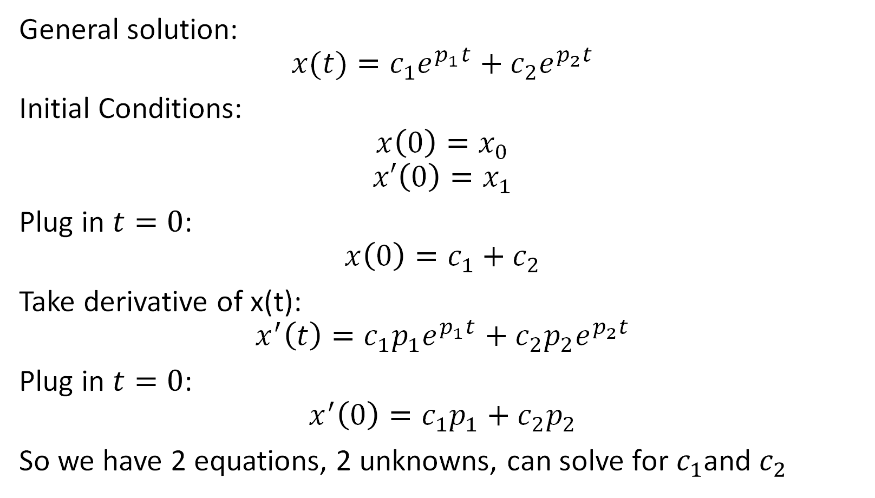
Differential Equations
General solution:
$$x(t)=c_{1}e^{p_{1}t}+c_{2}e^{p_{2}t}$$
Initial Conditions:
$$x\left(0\right)=x_{0}$$
$$x′\left(0\right)=x_{1}$$
Plug in $t=0$:
$$x\left(0\right)=c_{1}+c_{2}$$
Take derivative of x(t):
$$x^{′}\left(t\right)=c_{1}p_{1}e^{p_{1}t}+c_{2}p_{2}e^{p_{2}t}$$
Plug in $t=0$:
$$x^{′}\left(0\right)=c_{1}p_{1}+c_{2}p_{2}$$
So we have 2 equations, 2 unknowns, can solve for $c_{1}$and $c_{2}$

Slide 7
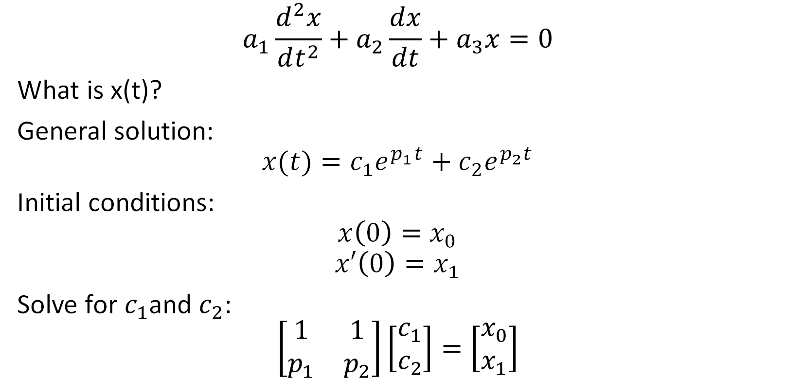
Differential Equations
$$a_{1}\frac{d^{2}x}{dt^{2}}+a_{2}\frac{dx}{dt}+a_{3}x=0$$
What is x(t)?
General solution:
$$x(t)=c_{1}e^{p_{1}t}+c_{2}e^{p_{2}t}$$
Initial conditions:
$$x\left(0\right)=x_{0}$$
$$x′\left(0\right)=x_{1}$$
Solve for $c_{1}$and $c_{2}$:
$$\left[\begin{matrix}1 & 1 \\ p_{1} & p_{2}\end{matrix}\right]\left[\begin{matrix}c_{1} \\ c_{2}\end{matrix}\right]=\left[\begin{matrix}x_{0} \\ x_{1}\end{matrix}\right]$$

Slide 8
Practice Problems

Slide 9
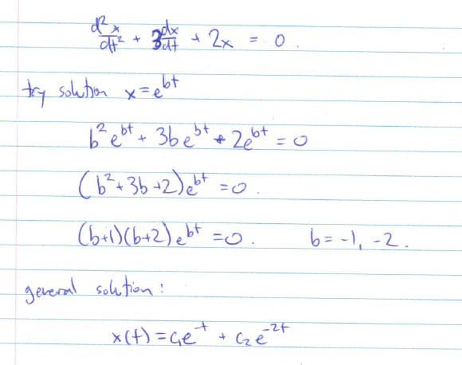
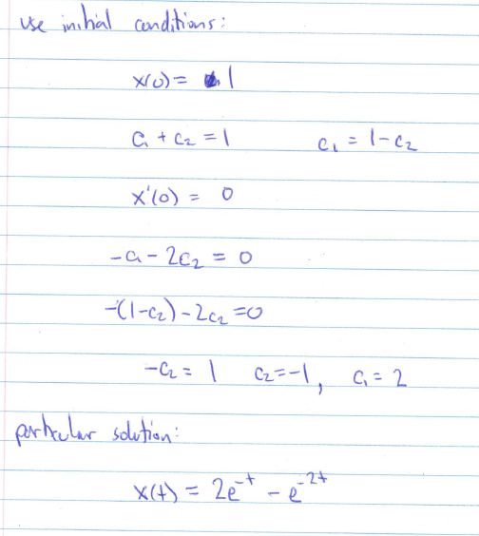
Solution to Practice Problem 1

Slide 10
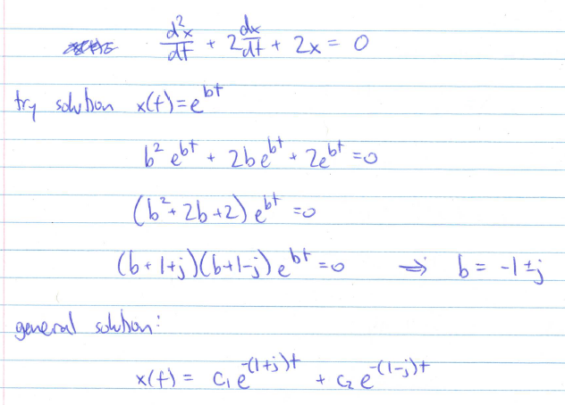
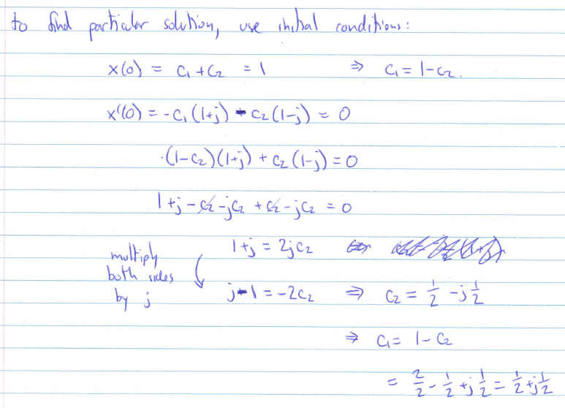
Solution to Practice Problem 2

Slide 11
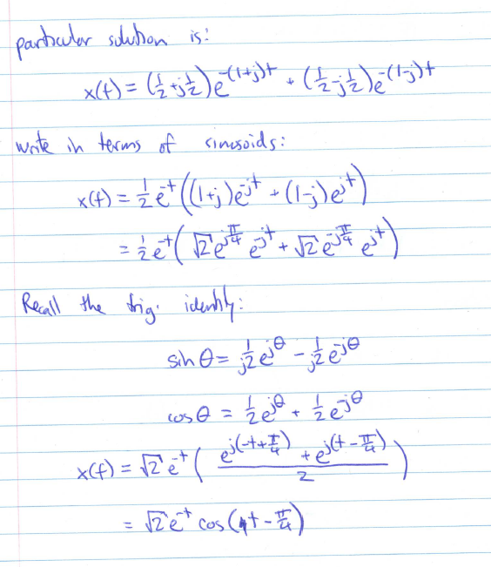
Solution to Practice Problem 2 (continued)

Slide 12
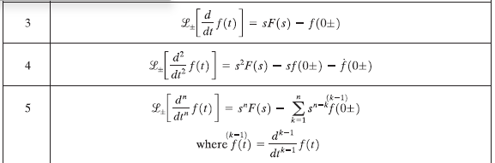
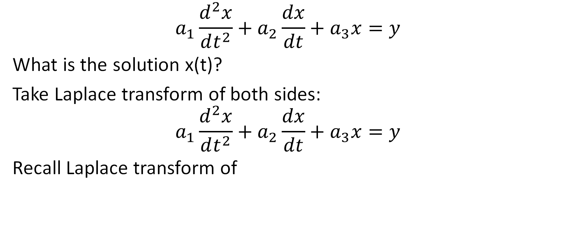
Laplace Transform
$$a_{1}\frac{d^{2}x}{dt^{2}}+a_{2}\frac{dx}{dt}+a_{3}x=y$$
What is the solution x(t)?
Take Laplace transform of both sides:
$$a_{1}\frac{d^{2}x}{dt^{2}}+a_{2}\frac{dx}{dt}+a_{3}x=y$$
Recall Laplace transform of

Slide 13
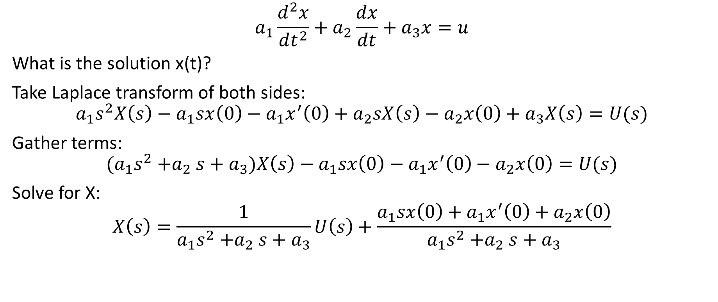
Laplace Transform
$$a_{1}\frac{d^{2}x}{dt^{2}}+a_{2}\frac{dx}{dt}+a_{3}x=u$$
What is the solution x(t)?
Take Laplace transform of both sides:
$$a_{1}s^{2}X\left(s\right)−a_{1}sx\left(0\right)−{a_{1}x}^{′}\left(0\right)+a_{2}sX\left(s\right)−a_{2}x\left(0\right)+a_{3}X\left(s\right)=U(s)$$
Gather terms:
$${(a}_{1}s^{2}{+a}_{2}s+a_{3})X\left(s\right)−a_{1}sx\left(0\right)−{a_{1}x}^{′}\left(0\right)−a_{2}x\left(0\right)=U(s)$$
Solve for X:
$$X\left(s\right)=\frac{1}{a_{1}s^{2}{+a}_{2}s+a_{3}}U\left(s\right)+\frac{a_{1}sx\left(0\right)+{a_{1}x}^{′}\left(0\right)+a_{2}x\left(0\right)}{a_{1}s^{2}{+a}_{2}s+a_{3}}$$
Forced response
Response due to initial conditions

Slide 14
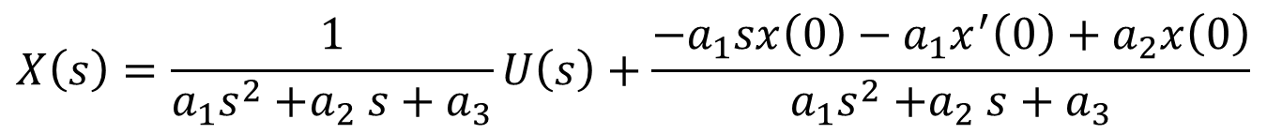
Laplace Transform
Transfer function
$$X\left(s\right)=\frac{1}{a_{1}s^{2}{+a}_{2}s+a_{3}}U\left(s\right)+\frac{{−a}_{1}sx\left(0\right)−{a_{1}x}^{′}\left(0\right)+a_{2}x\left(0\right)}{a_{1}s^{2}{+a}_{2}s+a_{3}}$$
Forced response
Response due to initial conditions

Slide 15
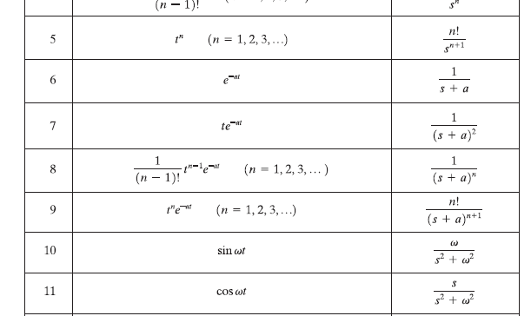
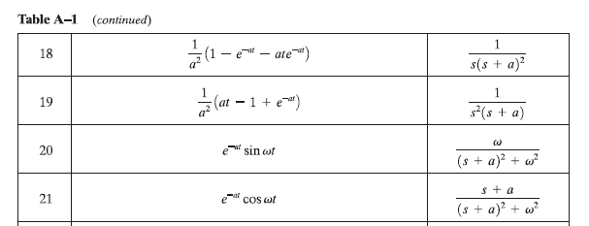
Practice Problems

Slide 16
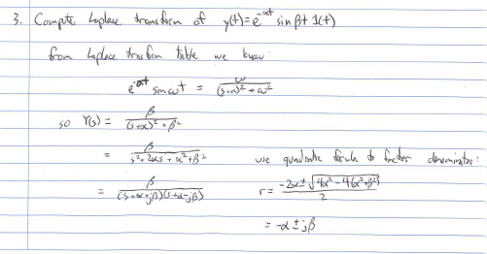
Solutions to Practice Problems

Slide 17
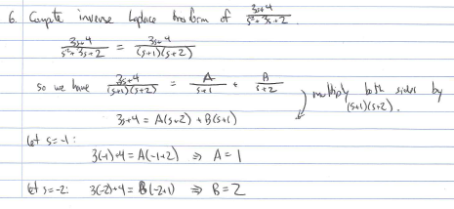
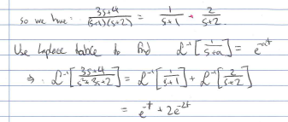
Solutions to Practice Problems

